Slide 1
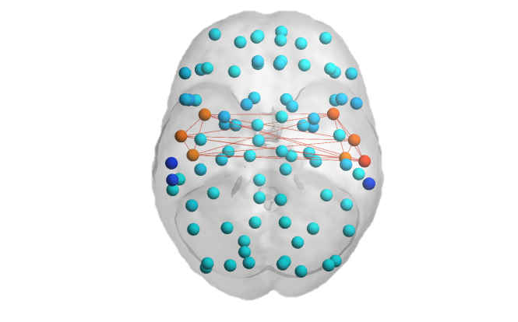
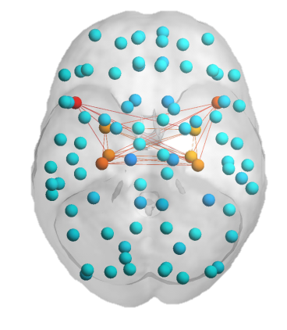
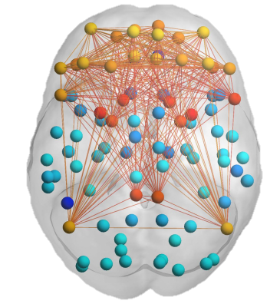
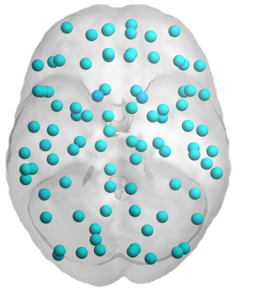



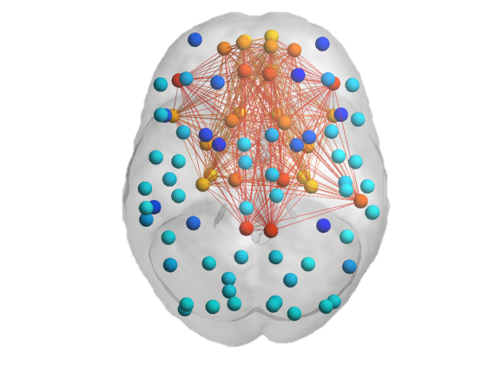


Amygdala-Hippocampus
Insula-Auditory
FN-DMN-Striatum
≥0.20 for whole group
rrMDD>controls
Neutral: whole group and rrMDD vs Controls
Controls>rrMDD
Prefrontal-Striatum
Global
Somatosensory-Visual
Visual
Prefrontal-Limbic
Visual-Hippocampus
Somatosensory-Insula

Slide 2
Amygdala-Hippocampus
Insula-Auditory
FN-DMN-Striatum
≥0.20
Whole Group Sad
Prefrontal-Striatum
Global
Somatosensory-Visual
Visual
Prefrontal-Limbic
Visual-Hippocampus
Somatosensory-Insula

Slide 3
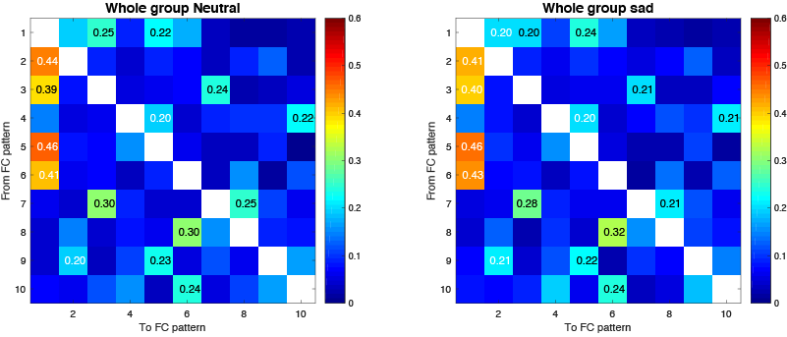
Switching probabilities whole group

Slide 4
Amygdala-Hippocampus
Insula-Auditory
FN-DMN-Striatum
Prefrontal-Striatum
Global
Somatosensory-Visual
Visual
Prefrontal-Limbic
Visual-Hippocampus
Somatosensory-Insula

